Slide 1
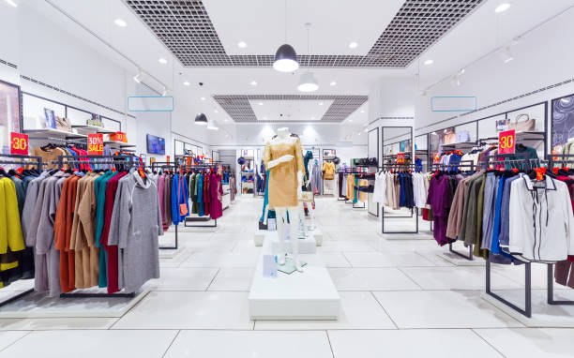
Vrinda Store Annual Report (2022)
Category :
Kurta
Set
Western dress
Top
Saree
Blouse
Bottom
Ethnic dress

Slide 2
OBJECTIVE
Vrinda store wants to create an annual sales report for 2022 , So that vrinda can understand their customers and generate more sales in 2023.

Slide 3
Sample Questions
Compare the sales and orders using single chart
Which month got the highest sales and orders ?
Who purchased more men or women in 2022 ?
What are different order status in 2022 ?
List top 5 states contributing to the sales ?
Relation between age and gender based on number of orders.
Which channel is contributing to maximum sales ?
Highest selling category ?

Slide 4
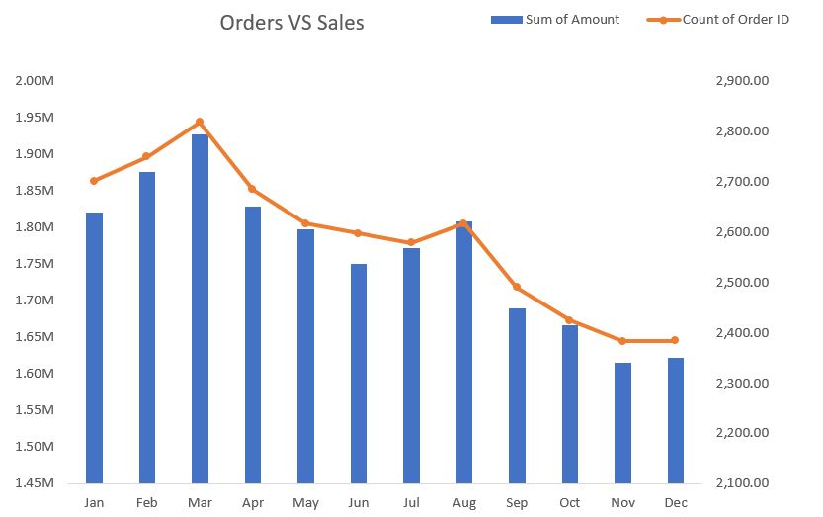
Compare the sales and orders using single chart
Insights

Slide 5
Which month got the highest sales and orders ?
We got the highest sales and orders in March month.

Slide 6
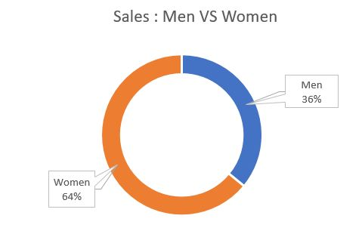
Who purchased more men or women in 2022 ?
Women Purchased more than men in 2022.

Slide 7
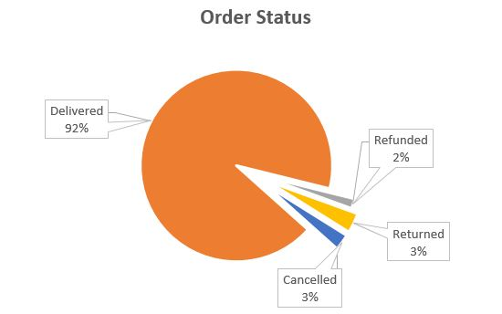
What are different order status in 2022 ?
There are 4 different order status .
Delivered
Returned
Cancelled
Refunded

Slide 8
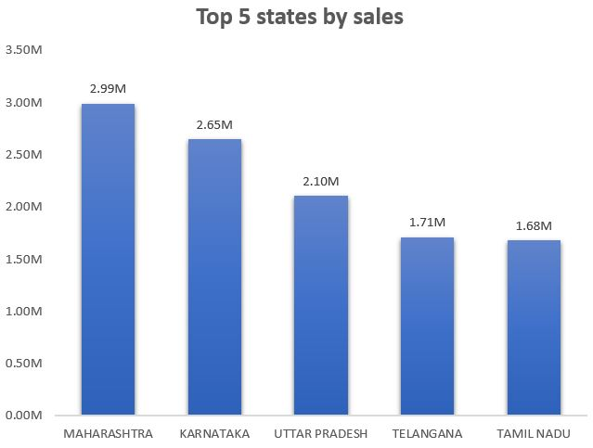
List top 5 states contributing to the sales ?

Slide 9
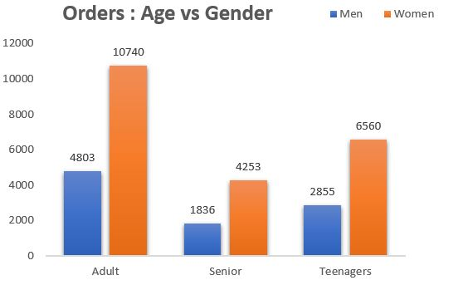
Relation between age and gender based on number of orders.
We received maximum orders from adult age women between ( 30 to 49 years old )

Slide 10
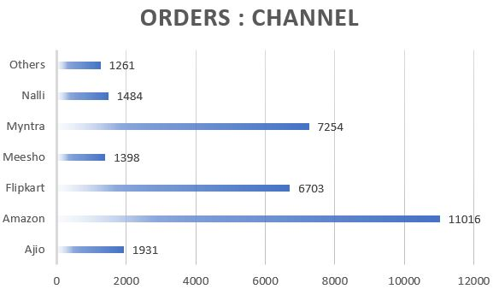
Which channel is contributing to maximum sales ?
We are receiving maximum sales from Amazon followed by Myntra and Flipkart.

Slide 11
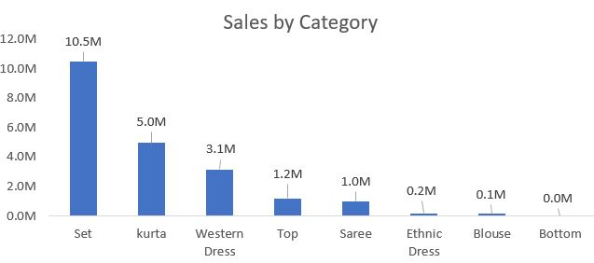
Highest selling category ?
We are receiving maximum sales from set category.

Slide 12
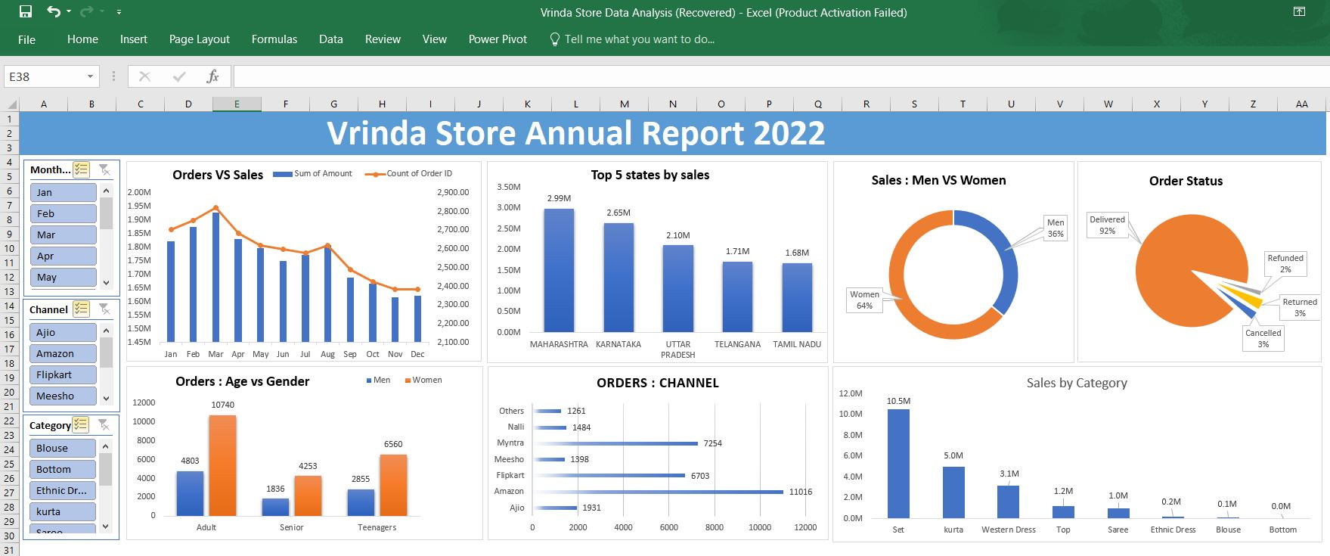
Dashboard

